Slide 1
ERO•SCAN®

Slide 2

ERO•SCAN®

Slide 3
Agenda
Introduction
Product Introduction
Main Features
Customer / User
Sales Configuration
Software
Components and Accessories
Competition
Success Stories
Marketing

Slide 4
1. Introduction - Otoacoustic Emissions
What are Otoacoustic Emissions?
Otoacoustic Emissions are soft sounds returned by the inner ear as a response to a sound event
These returned sounds can be measured with highly sensitive microphones
OAEs only occur in a normal functioning inner ear
If there is damage to inner or middle ear, OAEs can not be measured
What is an Otoacoustic emissions (OAE) test?
Objective evaluation of the inner ear function
Quick measurement with easy to interpret PASS/REFER result
Notes:
Image:
Test setup of measuring OAEs
Probe needs to be inserted in ear canal – fitting to ear canal (no gaps between probe tip and walls of ear canal)
Probe plays stimulus
Stimulus travels through ear canal, ear drum, middle ear to inner ear.
Hair cells in inner ear are set in motion
This motion moves the fluids in inner ear
This movement travels back through middle ear, ear drum -> is converted to sound signal, measured by probe in ear canal
OAEs present: healthy inner ear → does not equal normal hearing. Hearing impairment might have different cause (neuronal impairment)
OAEs not present: damaged inner ear -> doe not equal hearing loss. OAEs are highly inter subject dependable. Further diagnostics needed

Slide 5



1. Introduction
What are OAE tests used for?
Newborn Hearing Screening
School screening
Diagnostic evaluation of the inner ear
Evaluation of noise induced or age-related hearing loss
Auditory monitoring

Slide 6
1. Introduction
Two types of evoked OAEs are relevant for hearing testing
Transient-evoked OAEs (TEOAEs)
Evoked using a click stimulus with broad frequency range
The acoustic response from a click can be analysed in frequency bands to evaluate signal (response) and noise levels
Represent the average activity in a range of the cochlea (frequency band)
Distortion product OAEs (DPOAEs)
Evoked using a pair of primary tones
with the frequencies f1 and f2 and intensity of typically 65 dB SPL and 55 dB SPL
DPOAEs can be measured in higher frequencies up to 12 kHz
Represent the activity at a specific point in the cochlea (frequency specific)
Notes:
TEOAE: Click stimulus, travels through whole cochlea, movement of fluids in whole cochlea retransformed into sound
-> broadband stimulus, broadband answer
DPOAE: pure tone stimuli
-> single frequency stimulus, single frequency response -> single frequency screening result
-> measuring multiple frequencies one after another

Slide 7
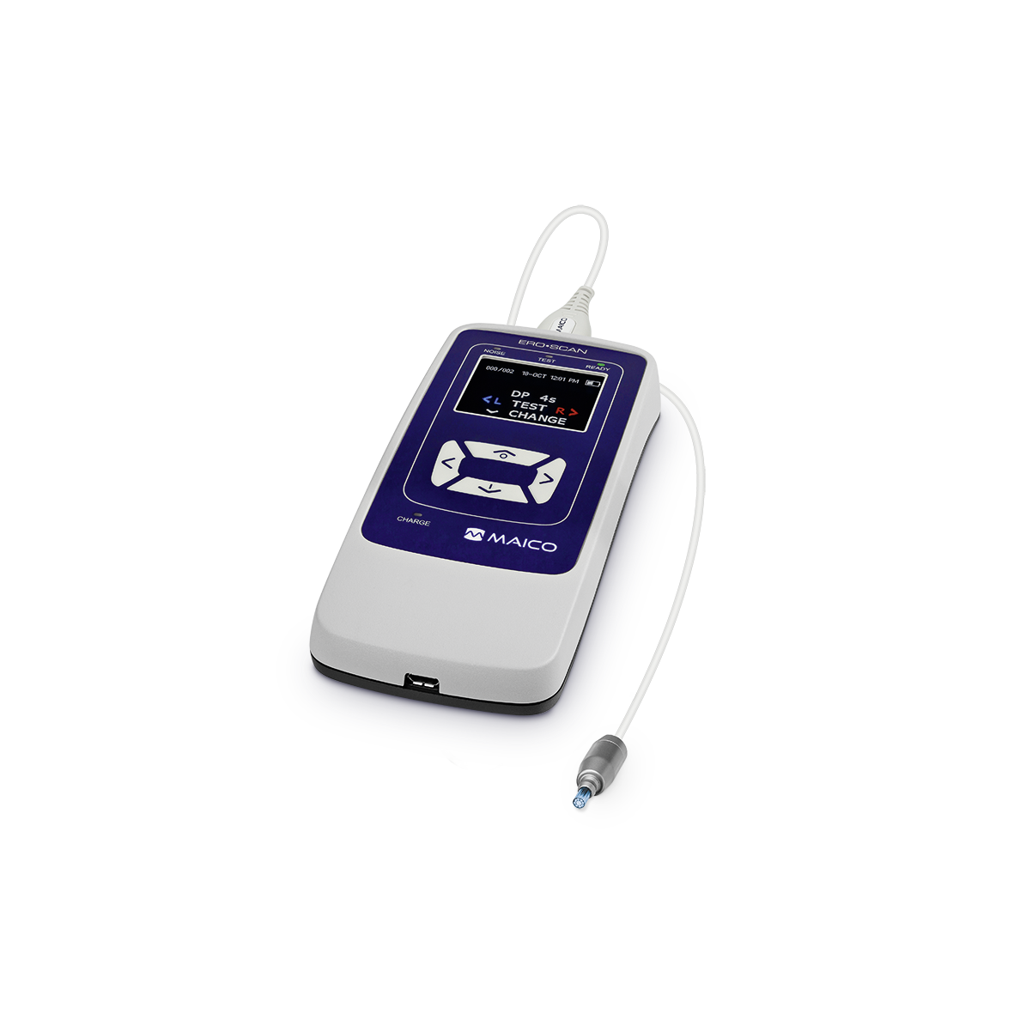
2. Product Introduction
Fast automatic OAE screening with Pass/Refer results
Screening and diagnostic measurements with TEOAE and/or DPOAE
Designed for testing patients of all ages
Small, lightweight ear probe
High noise immunity for operation in normal clinical environment
Flexible data management solutions
Wireless printing

Slide 8
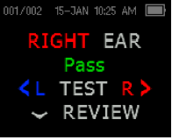
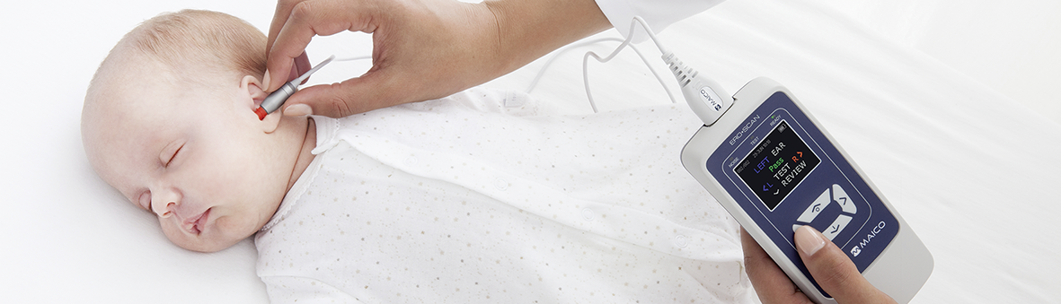
3. Main Features – Fast automatic OAE screening
Comprehensive PASS/REFER result
PASS will be displayed in green and Refer in orange.
Non-experts can understand test results easily
→ Very little training required

Slide 9
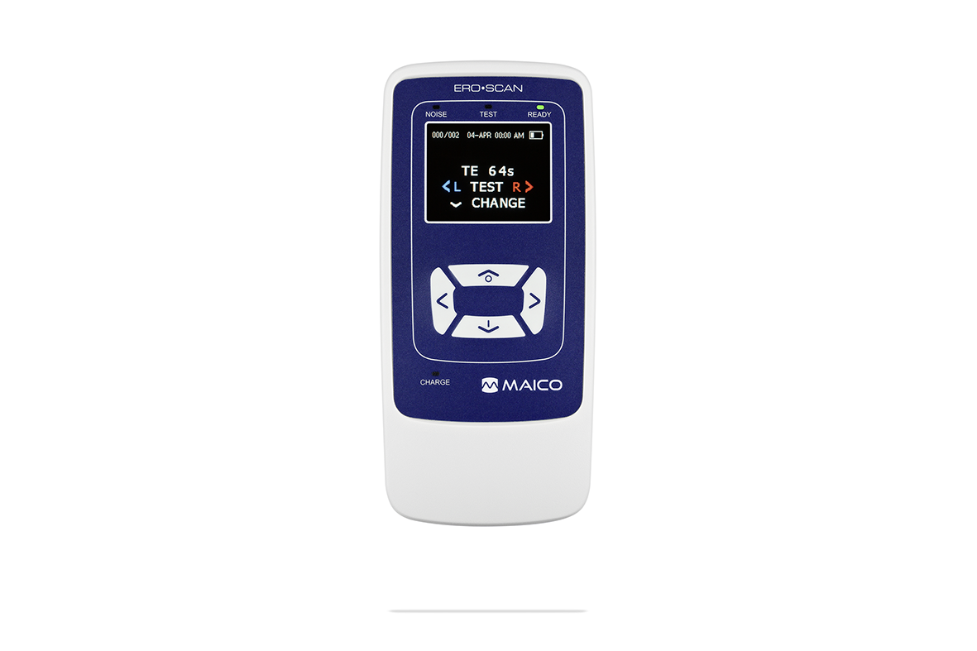
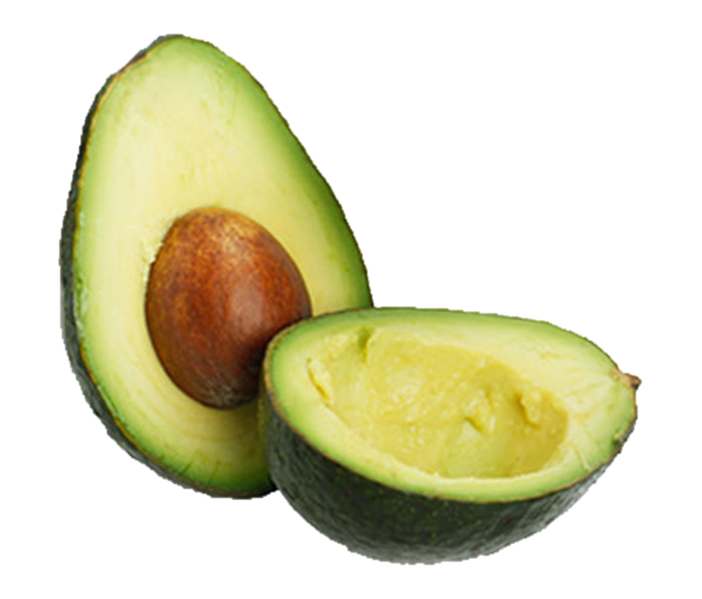
3. Main Features – Small and Lightweight
Portable device allows testing at different locations
Fits into pocket
Device with probe weighs less then 250 g
→ Supports convenient and flexible workflow
31 mm
66 mm
250 g
Notes:
[‎21.‎04.‎2020 09:21] Florian Schmitt (FSCH):
Zum starten des Screenings drückt man auf dem Startbildschirm lediglich nach rechts/links (die Ohrseite, die gemessen werden soll). dann startet die Messung

Slide 10
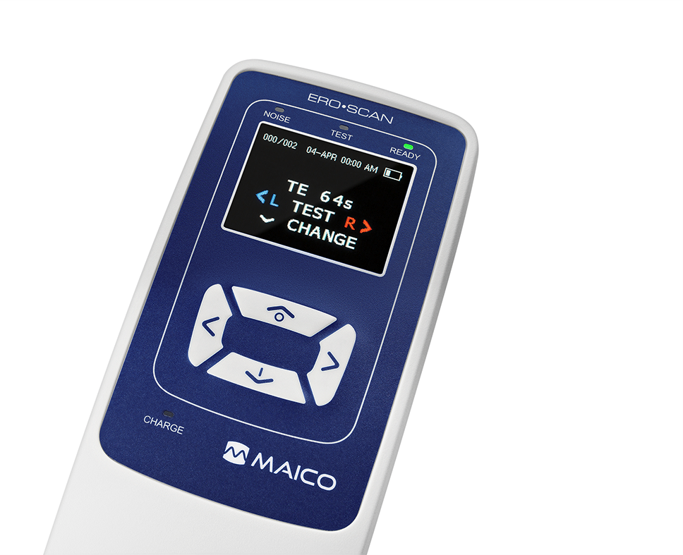
3. Main Features – One Finger Operation
4 curser buttons that can be operated with one hand
Start screening with 2 button clicks
→ Screening can be performed in no time
→ Very little training required
Start screening

Slide 11
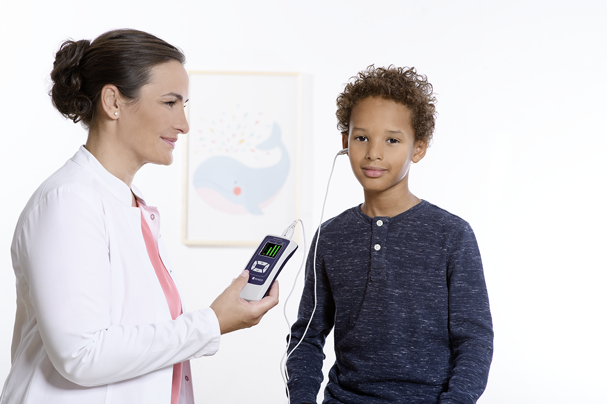
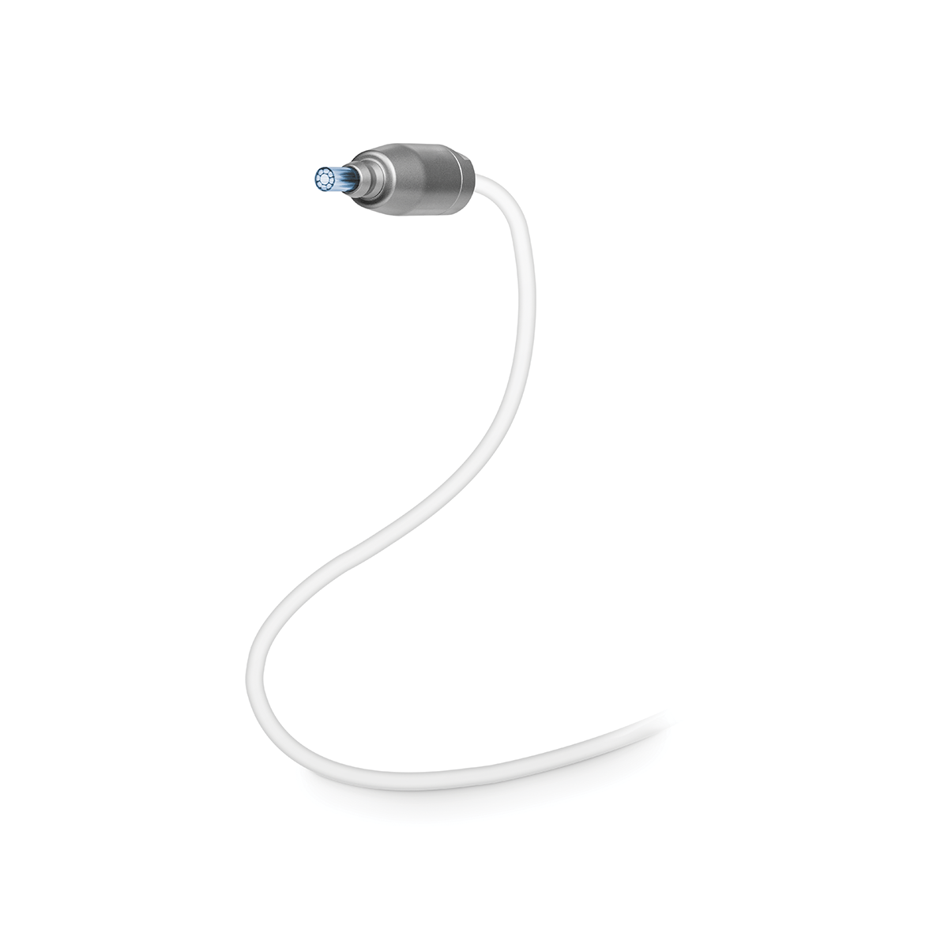
3. Main Features – Small, Lightweight and Robust Probe
Easy handling and probe placement in ear canal
Probe remains in the ear without holding, avoids noise that interferes with the test
→ Reliable results and confidence in the handling of the device

Slide 12

3. Main Features – Fast Bootup
Bootup takes less than 3 seconds, screening can be started right away by selecting the test ear
Time saving and easy operation
→ More time to focus on the patient

Slide 13
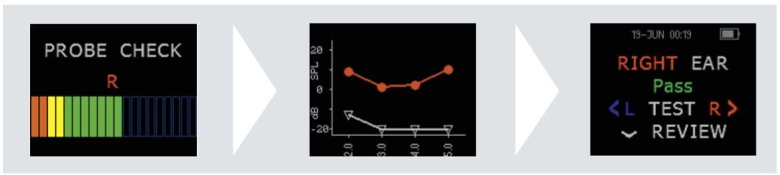
3. Main Features – Automatic Probe Fit Check
Before an actual OAE measurement is started, the ERO•SCAN® performs a probe fit check
Test conditions are evaluated
Only if test conditions are good, the test starts automatically
→ Guarantee of reliable test results

Slide 14
3. Main Features – Choice of Result View
Choice between SNR or value graph to show either signal-to-noise ratio or absolute OAE response and noise level values
Immediate and detailed feedback during the test
Result view can be adjusted to
the preferences of the operator
SNR graph
Value graph

Slide 15
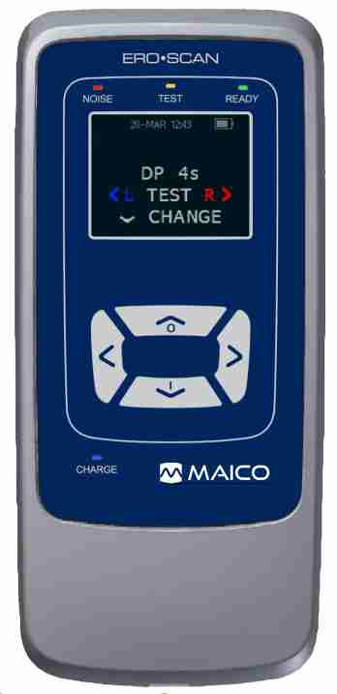
3. Main Features – Feedback LEDs
Operator is always informed about the test progress and status
Charging status is indicated
Supports the operator in
gaining reliable test results
Noise
Test
Ready
Charge

Slide 16
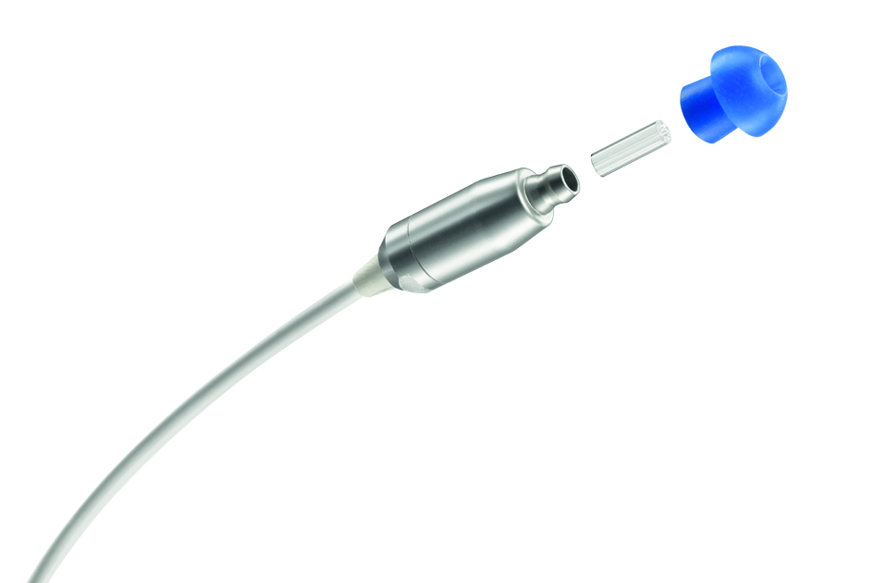
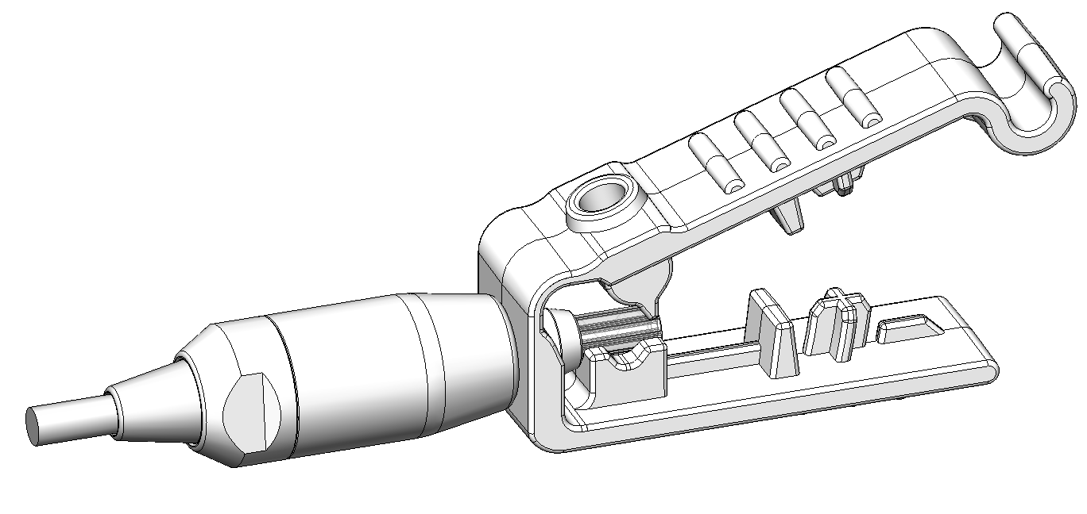
3. Main Features – Disposable Probe Tubes
Disposable probe tube is replaced after every test and gets never blocked
Dedicated probe tube removal tool to prevent damages of the probe
→ Saves the time needed to clean the probe tip
→ Avoids cross infection
→ More time to focus on the patient and documentation
Notes:
insofern wichtig, dass man die Sonde beschädigen könnte, wenn man dieses Tool nicht benutzt.

Slide 17
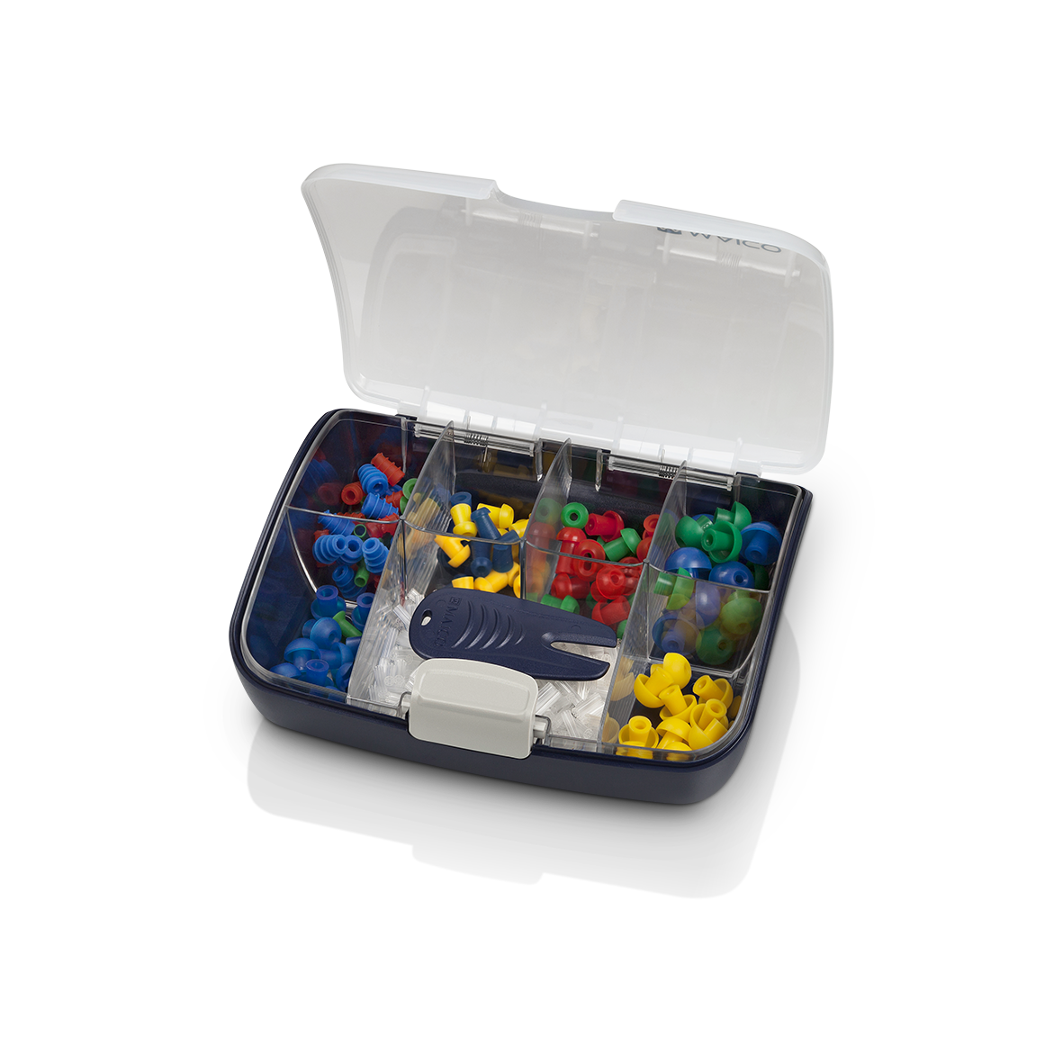
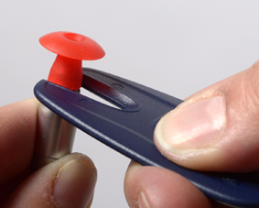
3. Main Features – Wide Range of Sanibel Eartips
Different sizes and shapes from premee, flanged, up to 15 mm mushroom
Eartip box with compartments
Convenient eartip removal tool
→ Ready to test patients of all ages

Slide 18
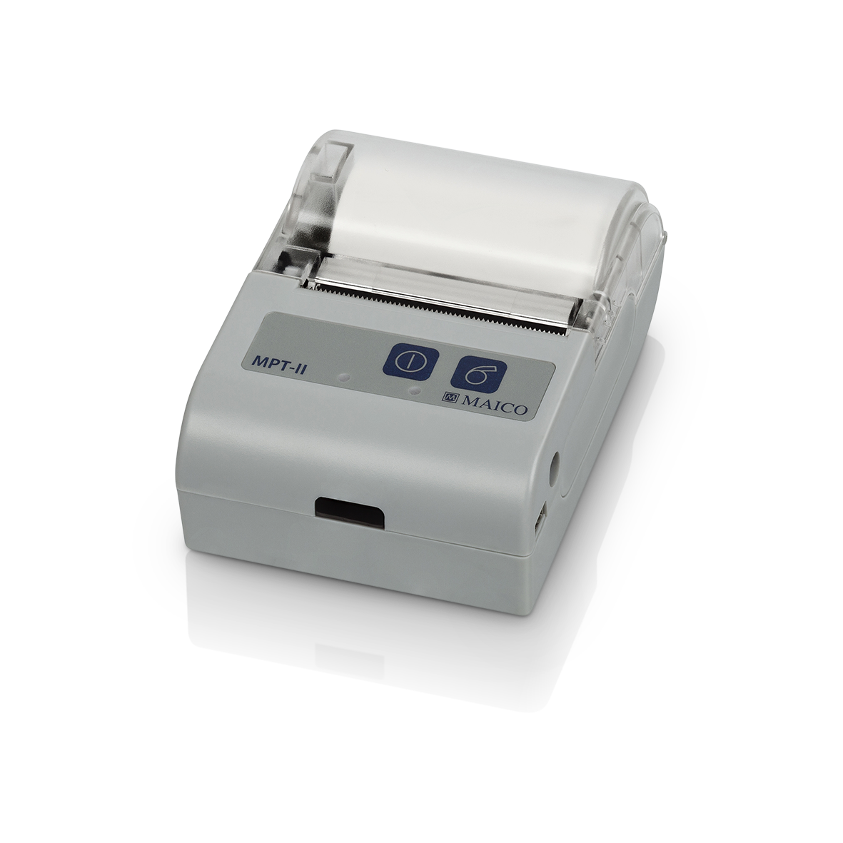
3. Main Features – Wireless Printing
Battery powered and ready to go
Results can be printed immediately by a wireless thermal printer
Support of convenient and
fast documentation

Slide 19
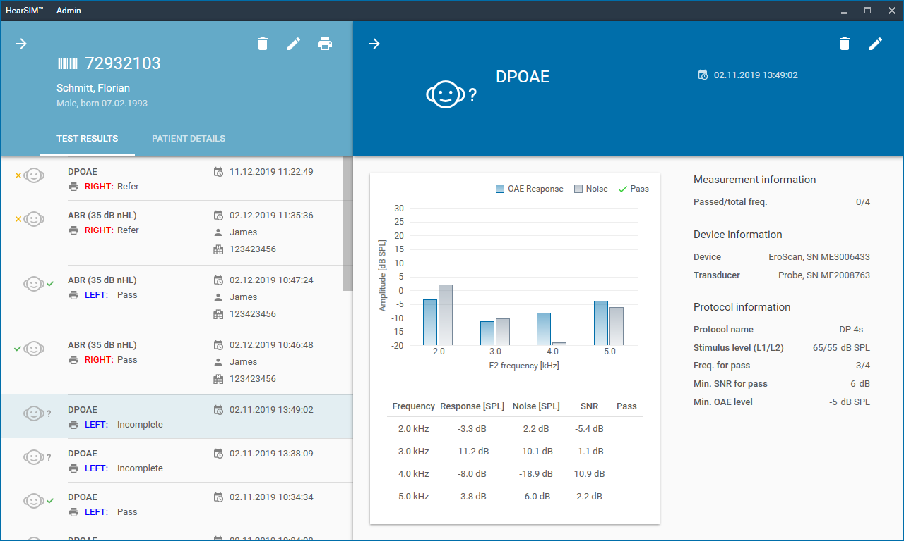
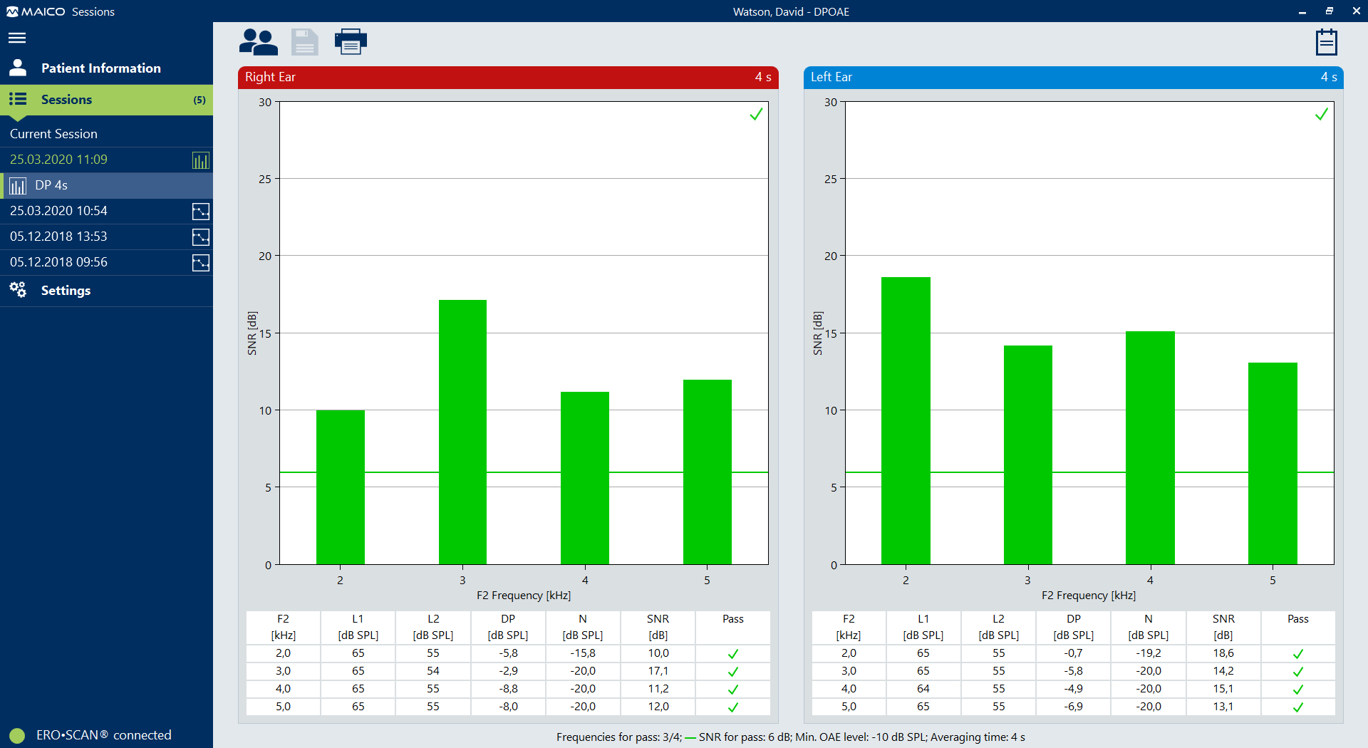
3. Main Features – Optional Software Solutions
HearSIM™
Dedicated for newborn hearing screening
Manage patients and test results
Tracking data export
Sessions
Manage also diagnostic results
Supports of many other MAICO devices, like touchTymp, MA 25e, MA 27e and MA 28
Flexible database and EMR integration
User can add software solution suitable for his needs

Slide 20
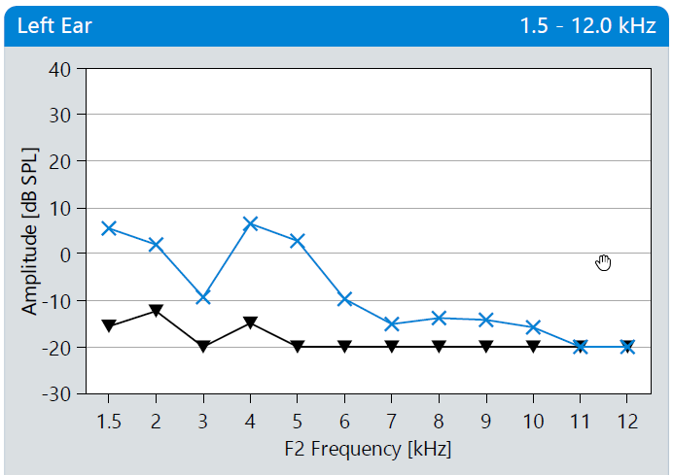
3. Main Features – High Frequency Measurement
High frequency DPOAEs up to 12 kHz
Auditory Monitoring
of ototoxic medication
noise-induced hearing loss
→ Wide range of applications

Slide 21
3. Main Features – Measurement Protocols DPOAE
 | Name | Frequencies (kHz) | Levels (dB SPL) | Averaging time
Screening | DP 4s | 2, 3, 4, 5 | 65 / 55 | 4 sec
 | DP 2s | 2, 3, 4, 5 | 65 / 55 | 2 sec
Diagnostic | DP 2.0-5.0 | 2, 3, 4, 5 | 40 to 70 | 0.5, 1, 2 , 4 sec
 | DP 1.5-6.0 | 1.5, 2, 3, 4, 5, 6 | 40 to 70 | 0.5, 1, 2 , 4 sec
 | DP 1.6-8.0 | 1.6, 2, 2.5, 3.2, 3.6, 4, 4.5, 5, 5.6, 6.3, 7.1, 8 | 40 to 70 | 0.5, 1, 2 , 4 sec
 | DP 1.5-12 | 1.5, 2, 3, 4, 5, 6, 7, 8, 9, 10, 11, 12 | 40 to 70 | 0.5, 1, 2 , 4 sec
Customizable parameters in Diagnostic version:
PASS SNR: 3 dB to 10 dB
Frequencies for Pass: 1 to 6

Slide 22
3. Main Features – Measurement Protocols TEOAE
 | Name | Frequency bands (kHz) | Levels (dB pe SPL) | Averaging time
Screening | TE 64s | 1.5, 2, 2.5, 3, 3.5, 4 | 80 | 64 sec
 | TE 32s | 1.5, 2, 2.5, 3, 3.5, 4 | 80 | 32 sec
Diagnostic | TE 1.5-4.0 | 1.5, 2, 2.5, 3, 3.5, 4 | 80 | 4, 8, 12, 16, 32, 64 sec
 | TE 0.7-4.0 | 1.5, 2, 3, 4, 5, 6 | 80 | 4, 8, 12, 16, 32, 64 sec
Customizable parameters in Diagnostic version:
PASS SNR: 3 dB to 10 dB
Frequencies for Pass: 1 to 6

Slide 23
3. Main Features – Flexibility in Screening Functionality
Available in 6 configurations
ERO•SCAN® DP screening
ERO•SCAN® TE screening
ERO•SCAN® DP + TE screening
ERO•SCAN® DP diagnostic
ERO•SCAN® TE diagnostic
ERO•SCAN® DP+TE diagnostic
→ Choose the device configuration, that perfectly fits to your needs

Slide 24

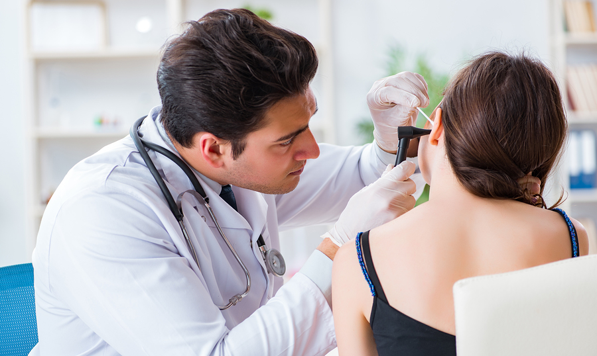

4. Customer / User
Newborn Hearing Screening
Early detection of newborn hearing loss
Screener
Nurse
Audiologist
ENT
Objective validation of hearing status
Physician
Assistant
Nurse
Audiologic Clinics/Hospitals
Diagnostic evaluation of the inner ear, auditory monitoring
Audiologist
Medical technical assistant
ENT doctor

Slide 25


4. Customer / User
School Screening
Objective validation of hearing status
Nurse
Teacher
Independent screener
Occupational Health
Early detection of noise induced hearing loss
Independent screener
Screening Commissioner
Screening Commissioner of Company

Slide 26
5. Sales Configuration
Step 1:
Choose test method TEOAE and/or DPOAE
Step 2:
Decide between Screener and Diagnostic
And choose configuration with or without printer
Step 3:
Add optional software
Notes:
Price for HearSIM includes OtoAccess

Slide 27
5. Sales Configuration - Overview
Step 1:
Select Test Method
Step 2:
Choose configuration
Step 3:
Add optional accessories
TEOAE
DPOAE
DPOAE and TEOAE
Select the required configuration of ERO•SCAN® Screener or Diagnostic, with or without Printer
DPOAE Screener
DPOAE Screener with printer
TEOAE Screener
TEOAE Screener with printer
…..
Optional Software
MAICO Sessions
Standalone
With OtoAccess® Database
With Noah Database
HearSIM with OtoAccess® Database (ERO•SCAN® Screener only)
Notes:
Price for HearSIM includes OtoAccess

Slide 28
6. Software – Sessions (optional)
Standalone, with OtoAccess® Database or NOAH
EMR integration interface (XML and GDT)
Combined support of audiometry, tympanometry and OAE devices
All OAE diagnostic and screening results supported
With OtoAccess Database:
Patient/result up- and download from PC to ERO•SCAN®
Optional: Worklist HL7 integration

Slide 29
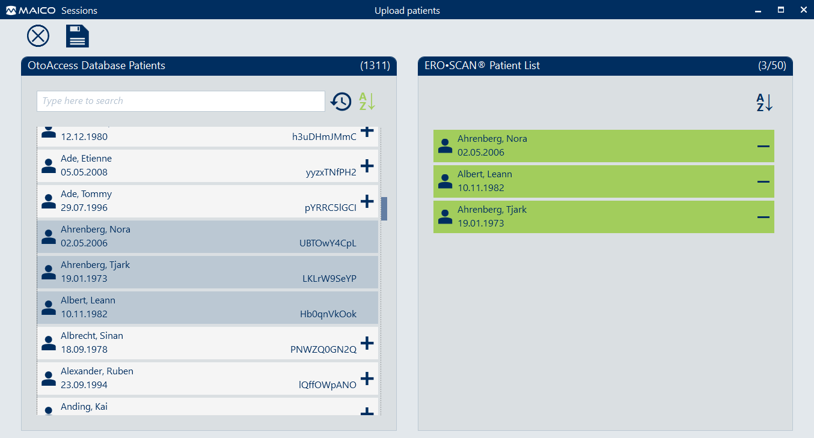
6. Software - Sessions Patient Transfer
Transfer list of patients from your database to the device
Perform screening on the corresponding patients
Transfer back to PC with results
Easy patient and result management system

Slide 30
6. Software – HearSIM™ (optional)
Management of patients and tests
Review and print test results
Transfer patients to the device
Perform tracking data export
Suitable for full featured screening programs
Please note: Only Compatible the ERO•SCAN® Screening versions

Slide 31
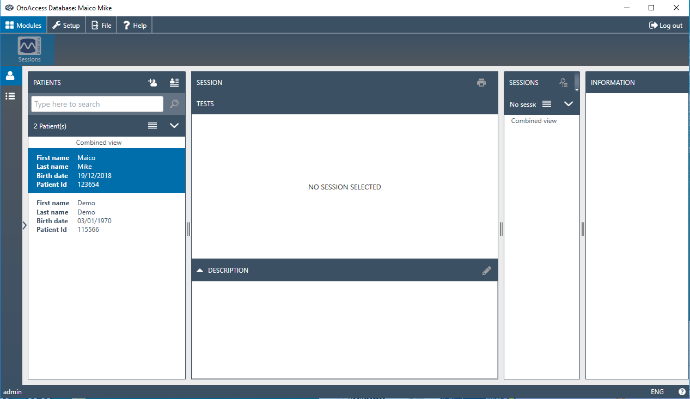
6. Software – OtoAccess® Database (optional)
Patient and result management
Hosts measurement modules from MAICO, Interacoustics and GSI devices
Perfect overview and easy session report and preview access
User management support
Client/server infrastructure
Database backend for HearSIM™

Slide 32
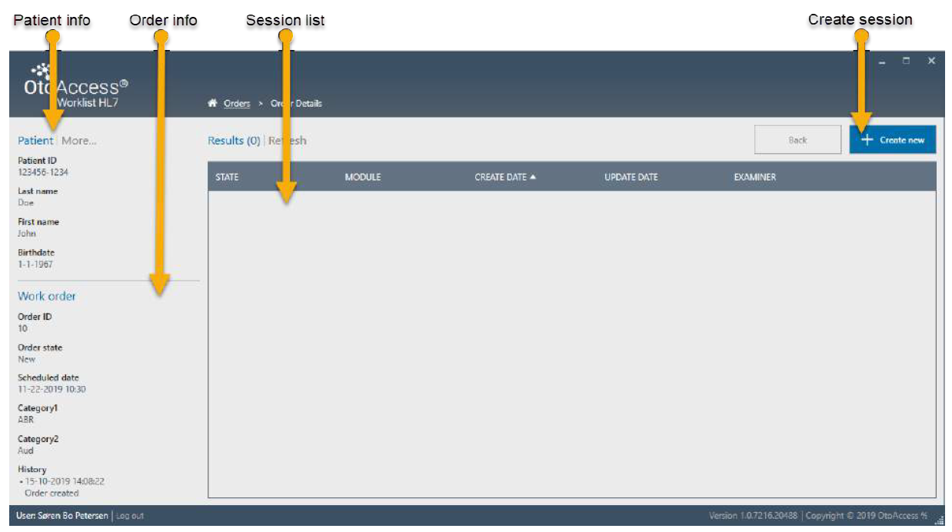
6. Software – OtoAccess® Worklist HL7 (optional)
OtoAccess® add-on for EMR integration
Flexible configuration setup, reducing HL7 integration effort for IT specialists
Received patients and all measurement results get stored in OtoAccess® database
Worklist HL7 displays the patients scheduled for testing
Possibility to send measurement results as preview back to EMR system
Notes:
Optional implementation and maintenance support packages

Slide 33
6. Software – Compatibility
Type | Application | Protocol | HearSIM | Sessions
TEOAE | Screening | TE 64s | ✔ | ✔
 |  | TE 32s | ✔ | ✔
 | Diagnostic | TE 1.5-4.0 |  | ✔
 |  | TE 0.7-4.0 |  | ✔
DPOAE | Screening | DP 4s | ✔ | ✔
 |  | DP 2s | ✔ | ✔
 | Diagnostic | DP 2.0-5.0 |  | ✔
 |  | DP 1.5-6.0 |  | ✔
 |  | DP 1.6-8.0 |  | ✔
 |  | DP 1.5-12 |  | ✔
Notes:
Roter Kasten einblenden um hervorzuheben dass diagnostic nicht mit hearsim geht

Slide 34
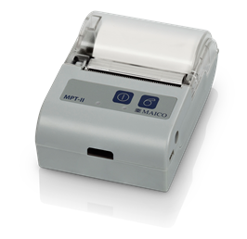
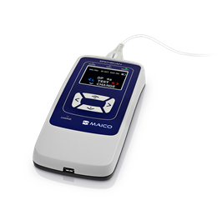
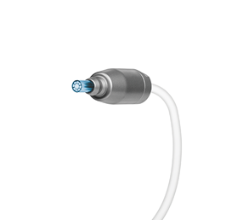
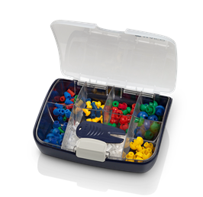
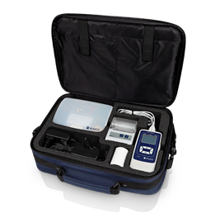


7. Components and Accessories
Standard Components
ERO•SCAN® device
Probe
Eartip set
Carrying case
Standard Components
Printer

Slide 35
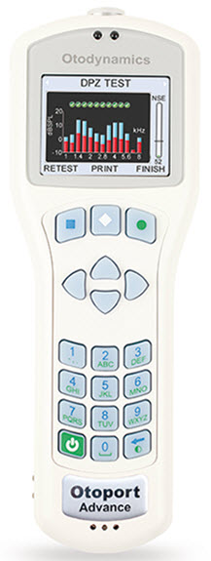
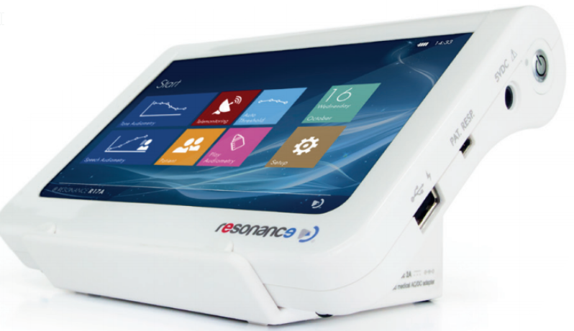
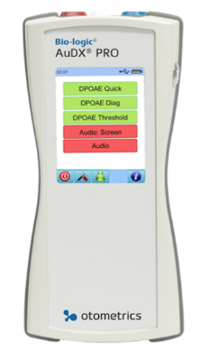
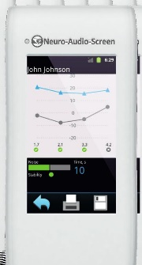
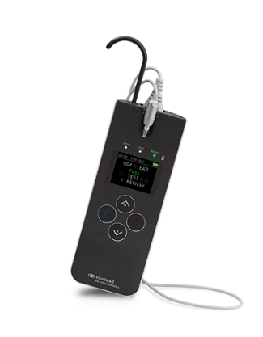
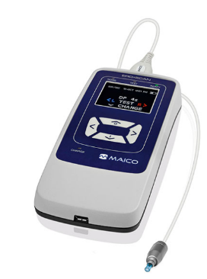
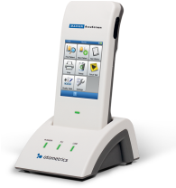
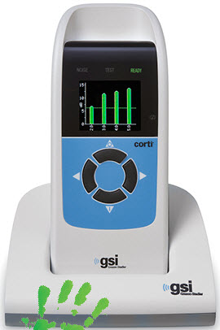
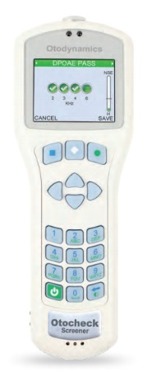
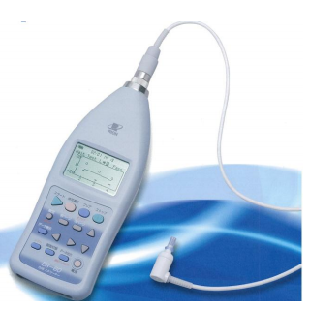
8. Competition – OAE only
many
Otodynamics Otoport Advance
Neurosoft Audio-Smart
Bio-Logix AudX Pro
Otometrics AccuScreen
Resonance r140
Otodynamics Otocheck Screener
GSI Corti
Interacoustics Otoread
MAICO ERO•SCAN®
RION ER60
<
few
low
high

Slide 36
8. Competition – OAE only
many
Otodynamics Otoport Advance
Neurosoft Audio-Smart
Bio-Logix AudX Pro
Otometrics AccuScreen
Resonance r140
Otodynamics Otocheck Screener
GSI Corti
Interacoustics Otoread
MAICO ERO•SCAN®
RION ER60
<
few
low
high

Slide 37
8. Competition – Conclusion
Device with lowest price
RION ER60: most simple DPOAE screening device
→ ERO•SCAN® costs more, but offers a variety of more features that are needed for the daily screening workflow (Software to organize screening results, simple display of PASS/REFER results etc.)
Device with most features
Otodynamics Otoport: Clinical OAE-device
→ ERO•SCAN® has less possibilities to adjust measurement properties, but offers an intuitive way to do reliable measurements that are suitable for 90% of the patients

Slide 38
8. Competition – Conclusion
Direct competitors
Resonance r140: touchscreen OAE device with a variety of settings, can also test up to 12 kHz
→ ERO•SCAN® offers less settings than the r140 but offers better handling since it is a handheld device that can be operated with one hand. Results are displayed simple and understandable
→ Overall ERO•SCAN® is a cost-effective OAE device,
covering all essential features and fitting to the needs of daily work

Slide 39



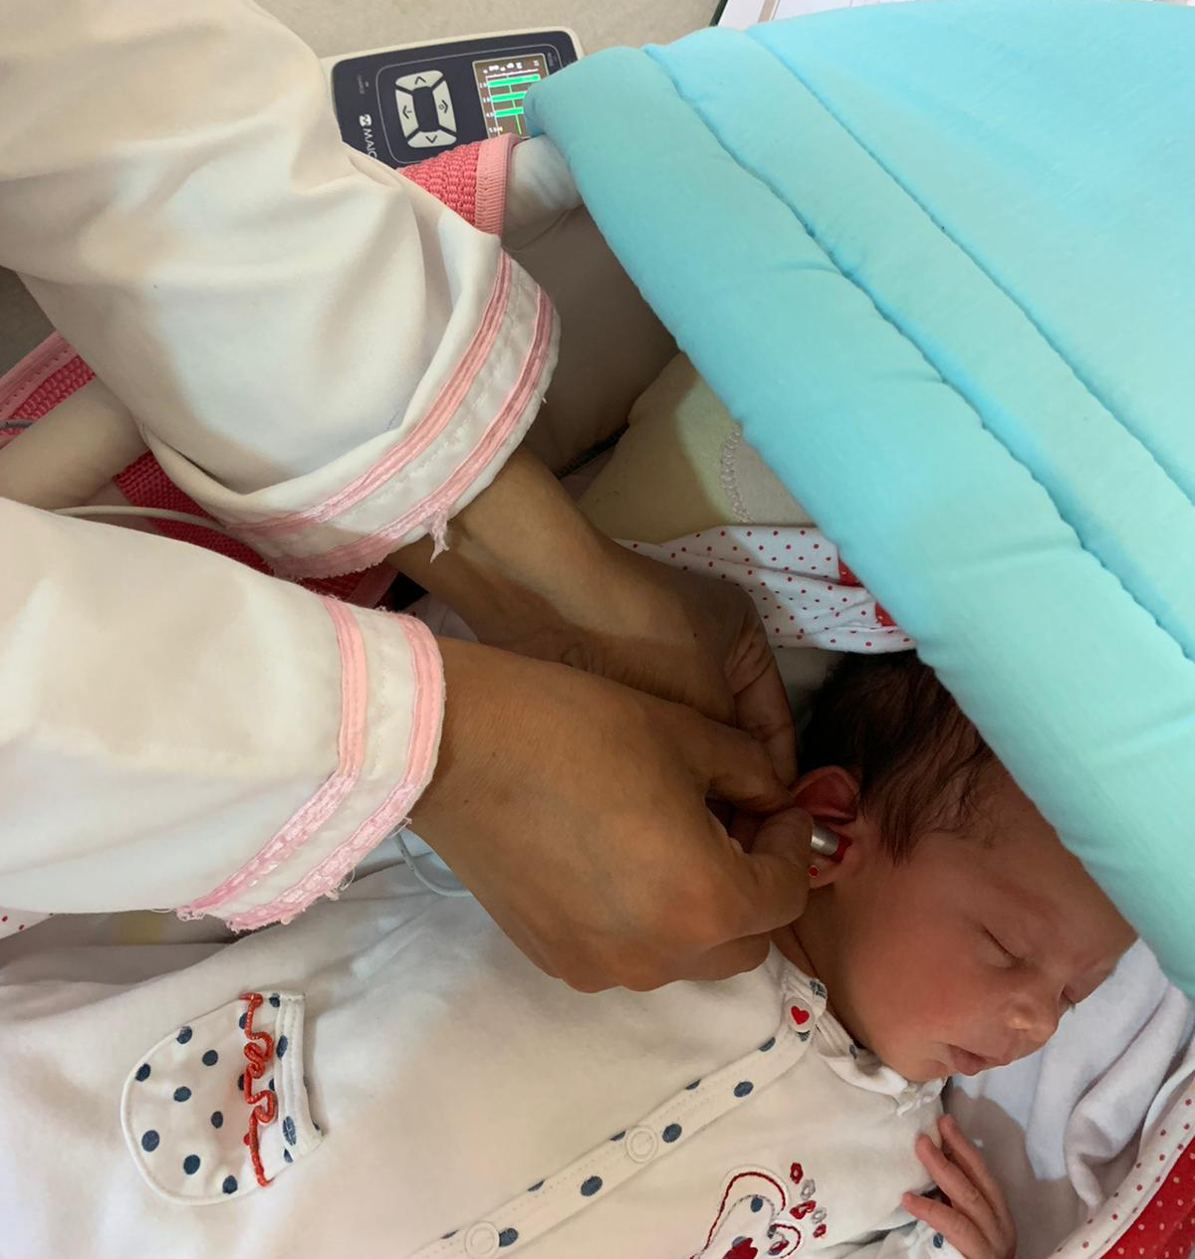
9. Success Stories
ERO•SCAN® is the most sold and used OAE device in China since more than 10 years
Many tenders and single sales with focus to NHS
Committed dealer network covering all regions and profound device knowledge
ERO•SCAN® won the largest tender for Egypt public health with more than 600 units
Providing the best price performance ratio
Notes:
Bilder? China → Daniel, Egypt→ Anke, → Umsatz EROSCAN 2019 in schools in USA → Michael

Slide 40

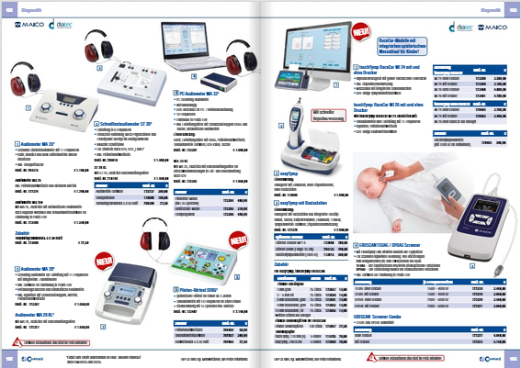
9. Success Stories
ERO•SCAN® is the first choice OAE device for school screening in USA
70% of ERO•SCAN®s sales were for use in schools
Direct sales via online shop: https://www.schoolhealth.com/
Intuitive and easy-to-use device require very little training and support for setup
Listed in one of Germany’s major printed catalogues Co-med for medical equipment supply
Large equipment supplier for general practitioners, Pediatricians, ENT and occupational health
Long lasting cooperation with good relationship and trust
Doctors flip through the catalogue and get aware of the ERO•SCAN®
70% for schools

Slide 41
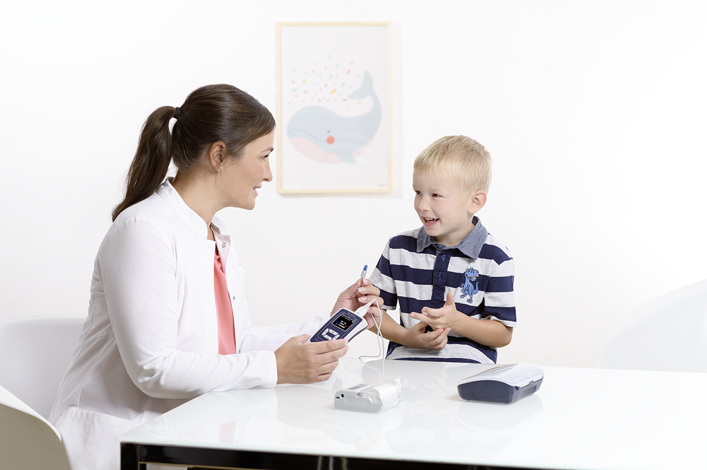
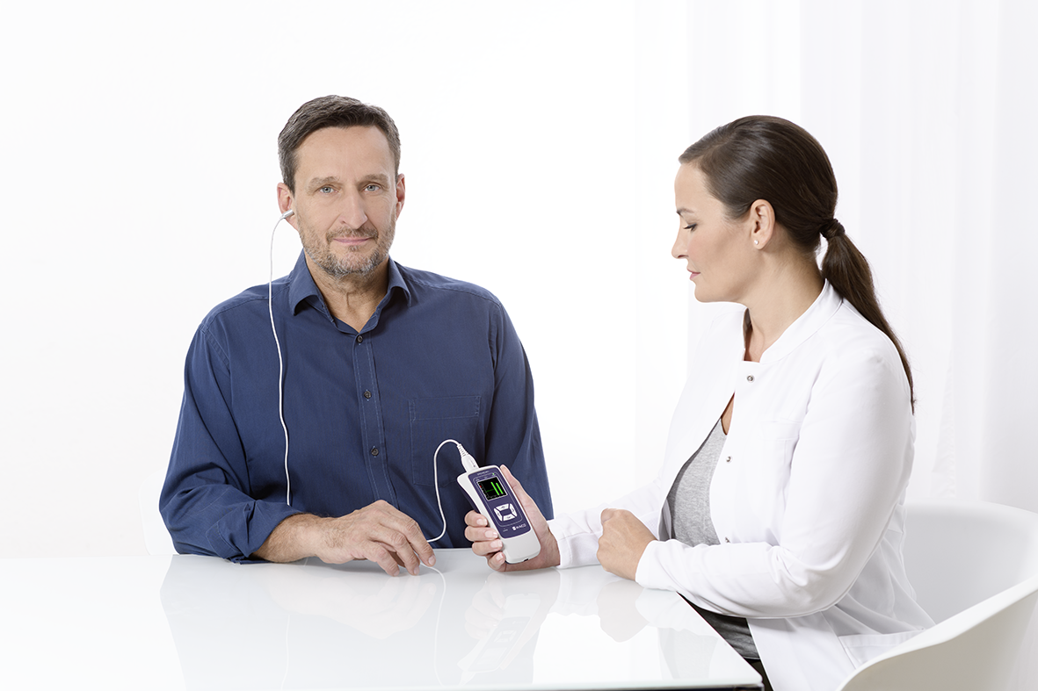
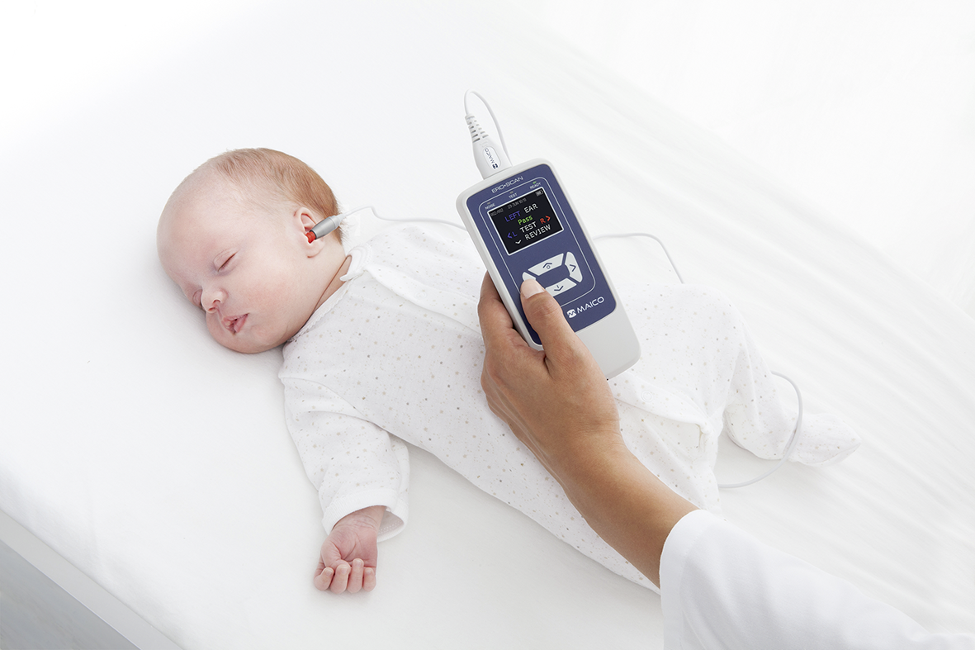
10. Marketing
People & Product Pictures

Slide 42
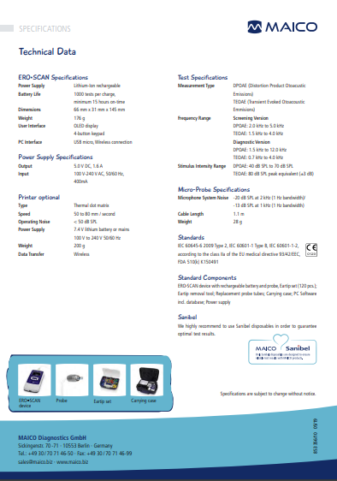
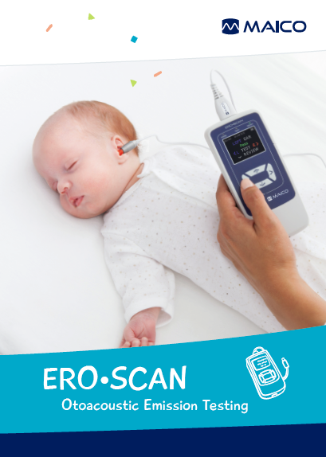
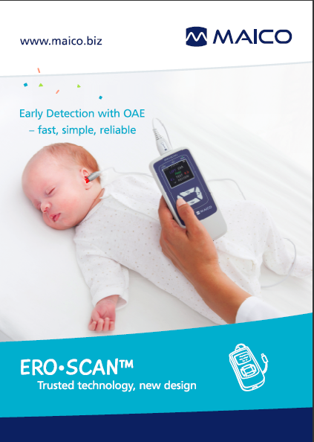
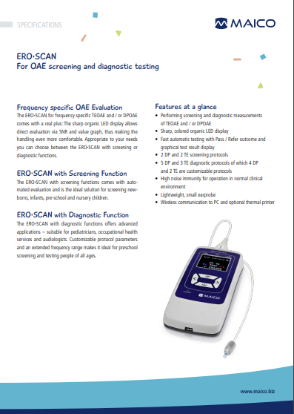
10. Marketing
Datasheet
Brochure
Poster A1 Format

Slide 43
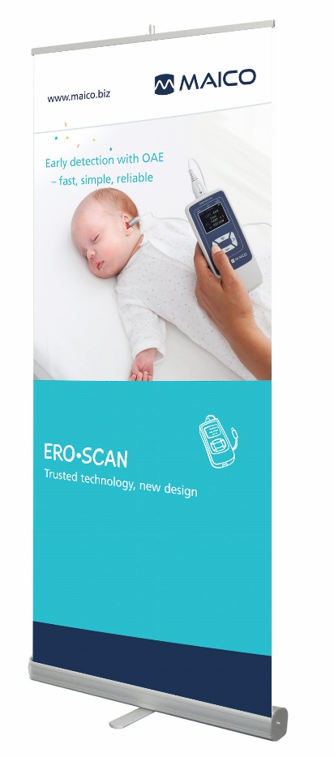
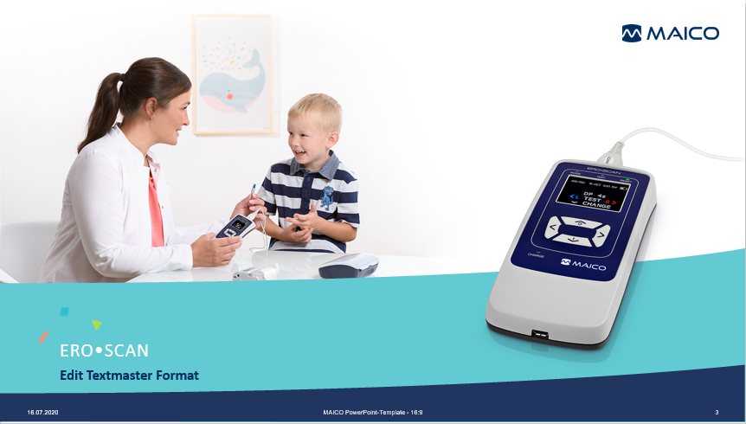
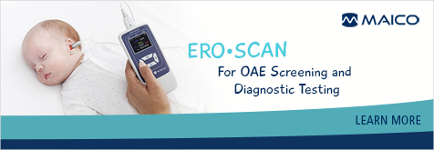
10. Marketing
Roll-up
PowerPoint Presentation Template 16:9
E-Mail Footer

Slide 44
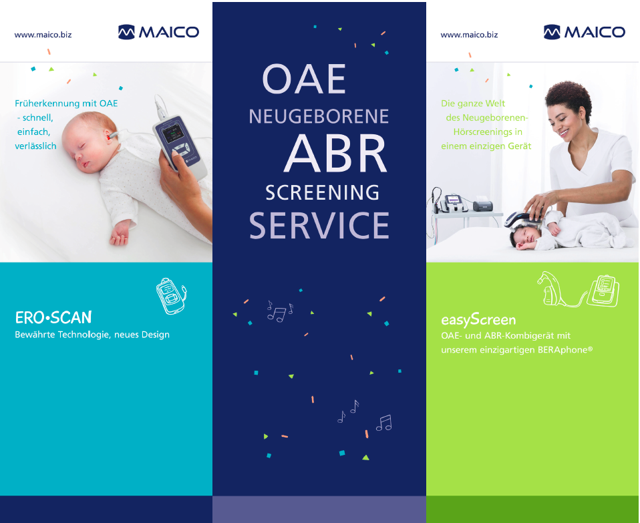


10. Marketing
Designs
according
to theme of
congress / exhibition adjustable
Graphics for Congresses/ Exhibitions

Slide 45
Thank you

