Slide 1
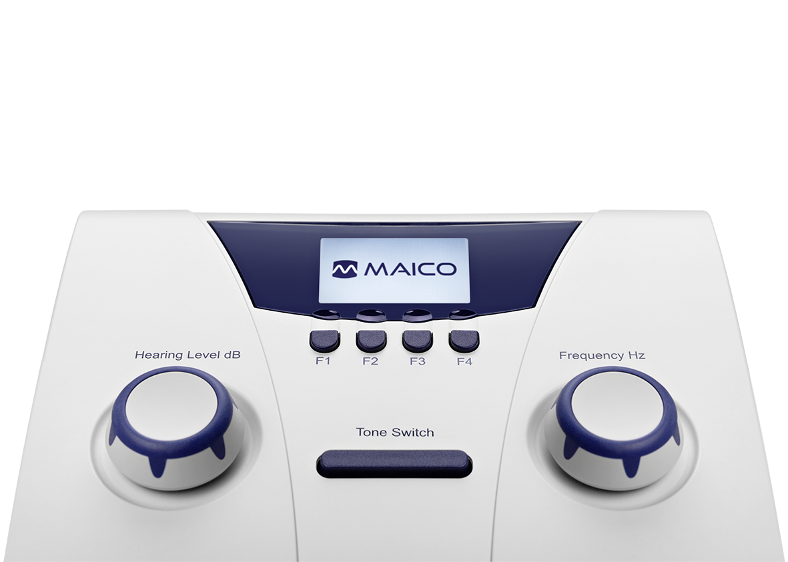
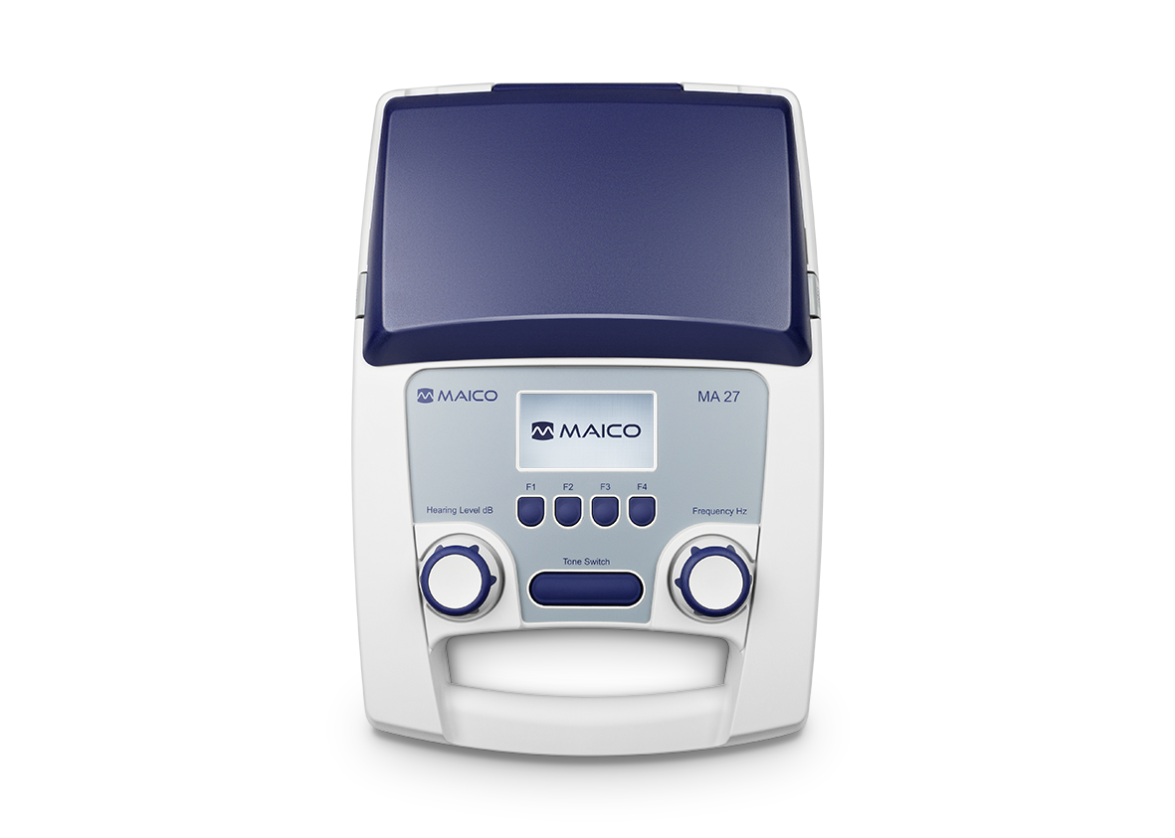
MA 25 and MA 27
Sales Presentation

Slide 2
Agenda
Introduction
Product introduction
Main Features
Customer / User
Sales Configuration
Marketing Materials

Slide 3
1. Introduction
What is Pure Tone Audiometry?
Gold standard for audiologic examination
Behavioral test used to measure hearing sensitivity
Defined as either screening or threshold search
Measures intensity as a function of frequency
What are Pure Tone Audiometry measurement used for?
Hearing screening
Diagnostic hearing evaluations
Occupational annual hearing exams
Auditory monitoring

Slide 4
1. Introduction
MA 25 and MA 27 uses Air Conduction Audiometry to evaluate hearing sensitivity
Hearing thresholds measured with tonal stimuli in frequency range 0.125 kHz to 8 kHz
Headphone placed on ears and used to present stimuli
Air conduction relies on the outer ear, middle ear, and inner ear
Effective measure of everyday hearing ability
Air conduction does not determine type of hearing loss (ie. conduction, mixed, sensorineural)
Identifies hearing loss is present through screening or threshold measurement
Notes:
TEOAE: Click stimulus, travels through whole cochlea, movement of fluids in whole cochlea retransformed into sound
-> broadband stimulus, broadband answer
DPOAE: pure tone stimuli
-> single frequency stimulus, single frequency response -> single frequency screening result
-> measuring multiple frequencies one after another

Slide 5
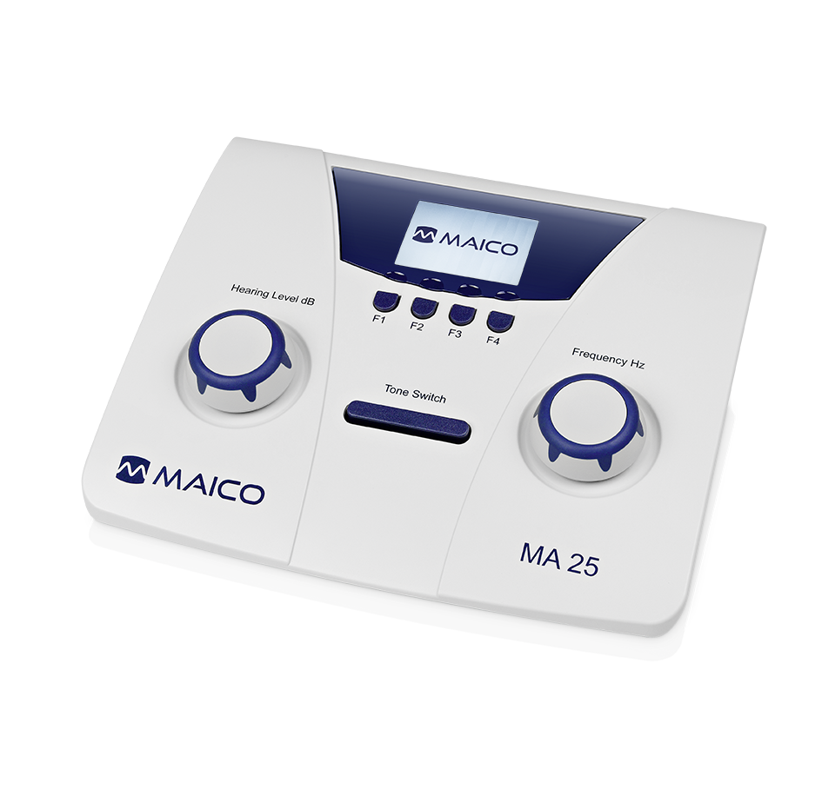
2. Product Introduction – MA 25/25e
Air conduction audiometer
Portable and lightweight
Easy fingertip navigation of frequency and hearing level
Designed for testing patients 3 years +
11 frequencies from 125 Hz to 8000 Hz
Test signals from -10 dB HL to 100 dB HL
Powered by batteries, power supply or USB cable to PC
MA 25e version including automated Hughson-Westlake test, talk forward and MAICO Sessions PC Software
Optional carrying case

Slide 6
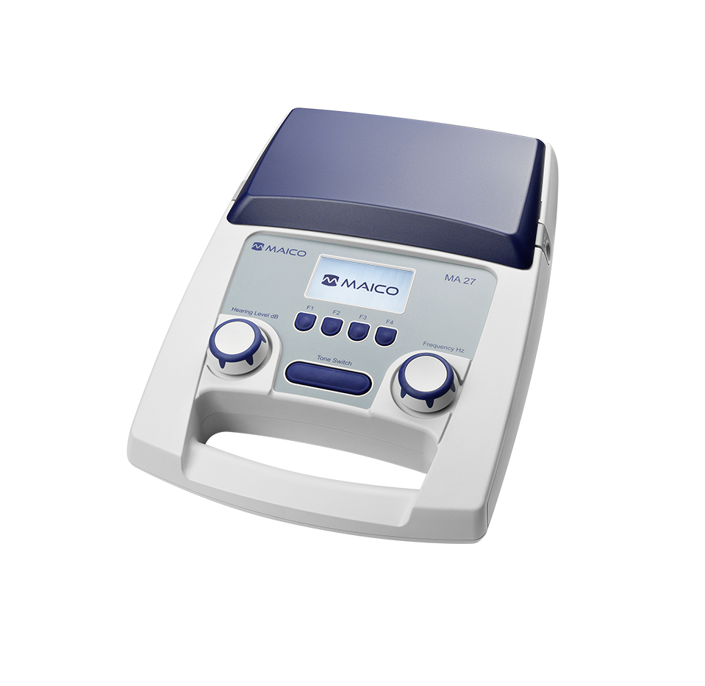
2. Product Introduction – MA 27/27e
Air conduction audiometer
Compact and portable with built-in handle
Integrated compartment for storing accessories
Designed for testing patients 3 years +
11 frequencies from 125 Hz to 8000 Hz
Test signals from -10 dB HL to 100 dB HL
Built-in talk forward microphone
Powered by power supply or USB cable to PC
MA 27e version including automated Hughson-Westlake test, talk forward and MAICO Sessions PC Software

Slide 7
3. Main Features – Air Conduction
Allows screening test measurements
Meets testing needs of patients 3 years +
Full frequency audiometer: 125, 250, 500, 750, 1000, 1500, 2000, 3000, 4000, 6000, 8000 Hz
Deselect frequencies not needed
Maximum output of 100 dB HL
→ Tailor testing needs to individual patient or setting

Slide 8

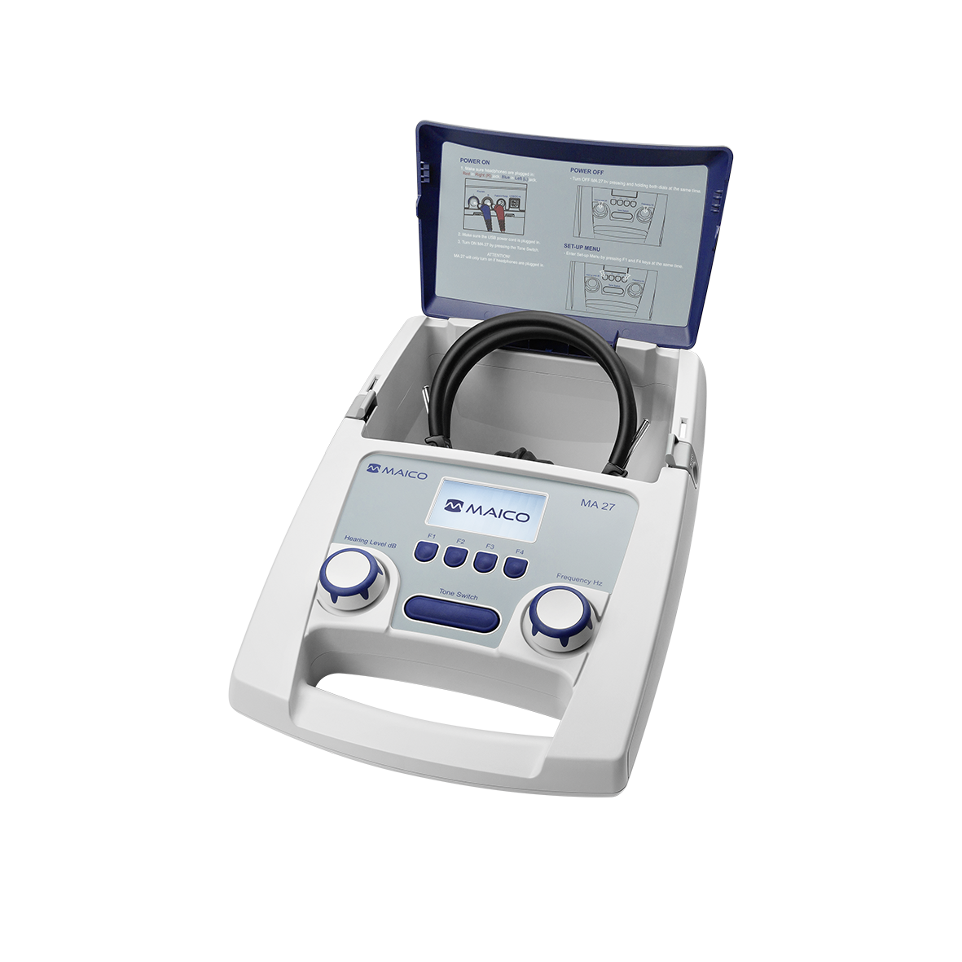
3. Main Features – Portable and Lightweight
MA 25
Extremely light with a weight of less than 1 kg
Small footprint and optional carrying case
Powered with AA batteries
MA 27
Built in handle and integrated compartment for easy storage of headset and accessories
Weighs less than 2.5 kg with all accessories
1 kg
→ Supports convenient and flexible workflow in the clinic or in the field

Slide 9
3. Main Features – Easy to Navigate
Easy fingertip operation
Large rubberized buttons with easy to read labels
Sturdy dials for quick frequency and level adjustment
→ Very little training required

Slide 10
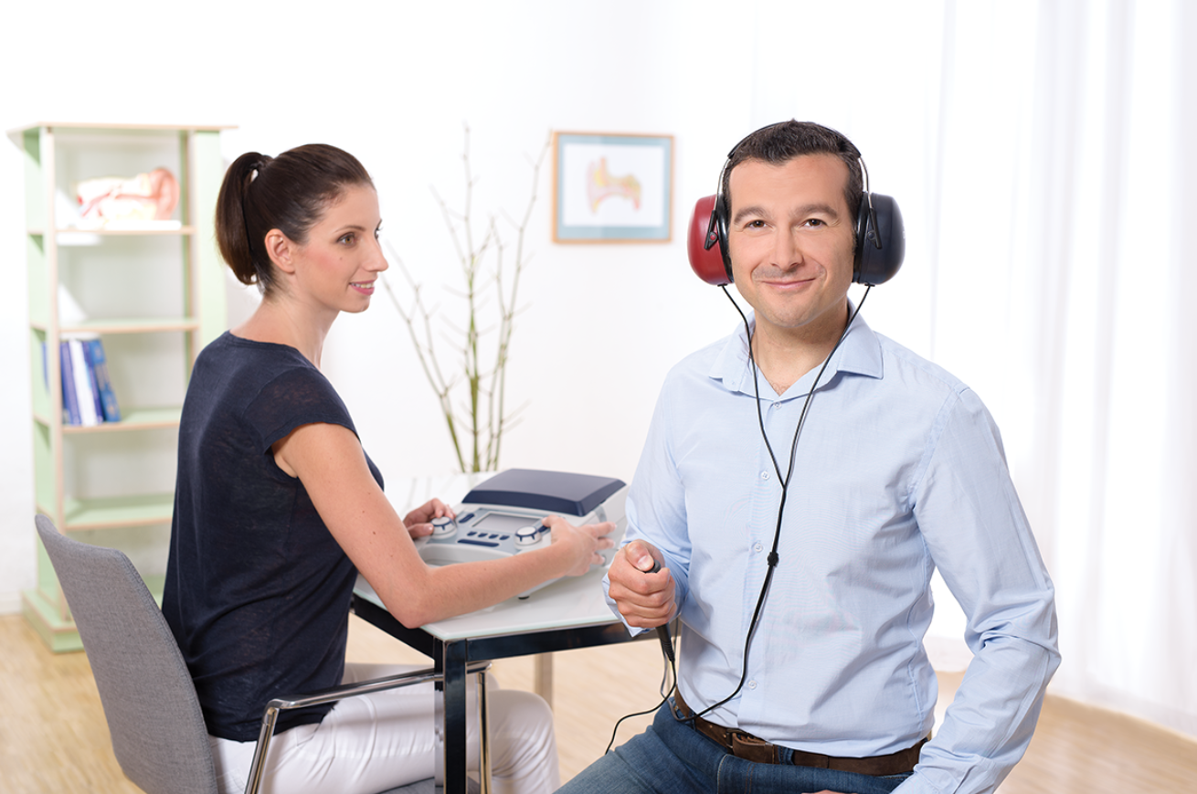
3. Main Features – Automatic Hughson-Westlake
Device performs and stores results automatically
Results displayed for tester review
Special settings to improve test time.
→ Simplify testing process
→ Focus on the patient

Slide 11
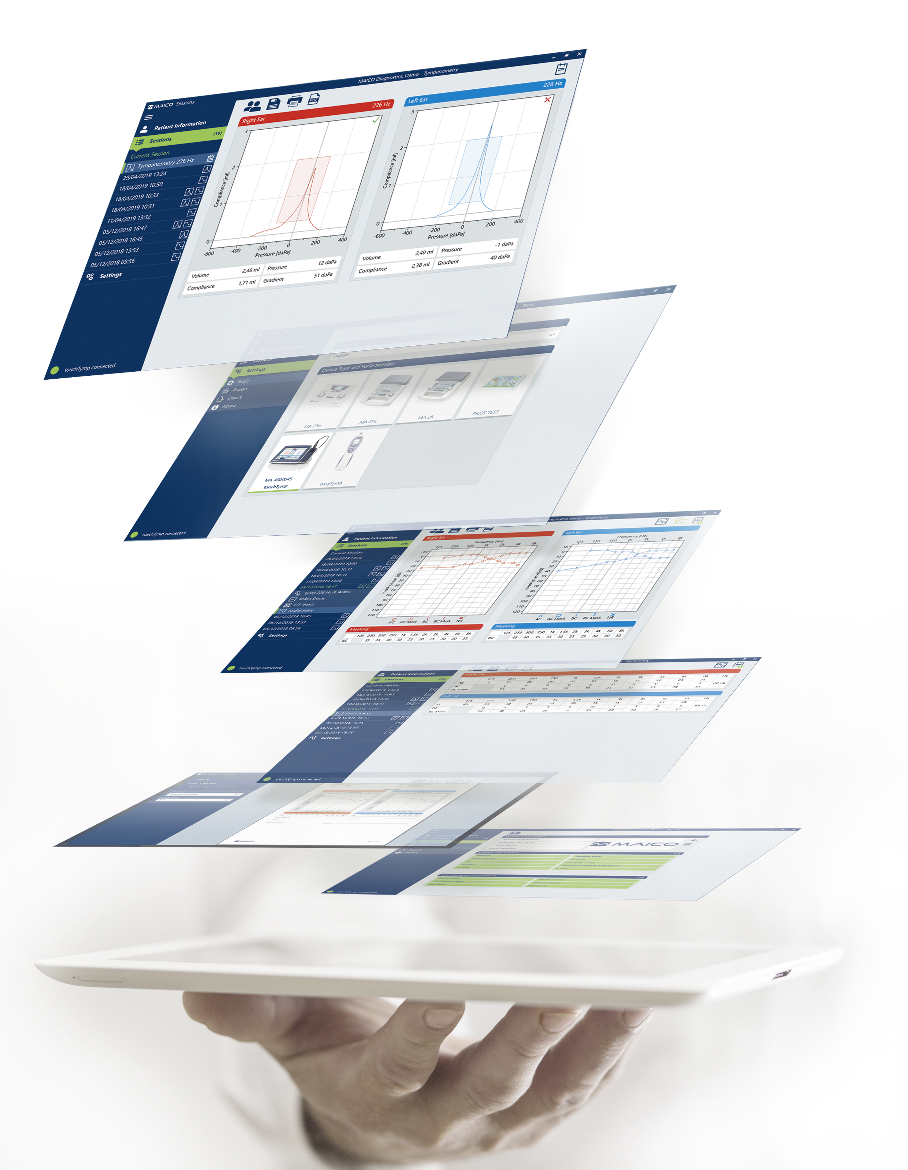
3. Main Features – Optional Software Solutions*
MAICO Sessions
Fast and intuitive software for data management and visualization for audiometry, immittance & OAE tests
Supported Databases
Long term storage of patients and results
OtoAccess® Database
Noah Database
HL7 integration
OtoAccess® Worklist HL7 (OtoAccess® Database add-on)
*Available for MA 25e and MA 27e

Slide 12
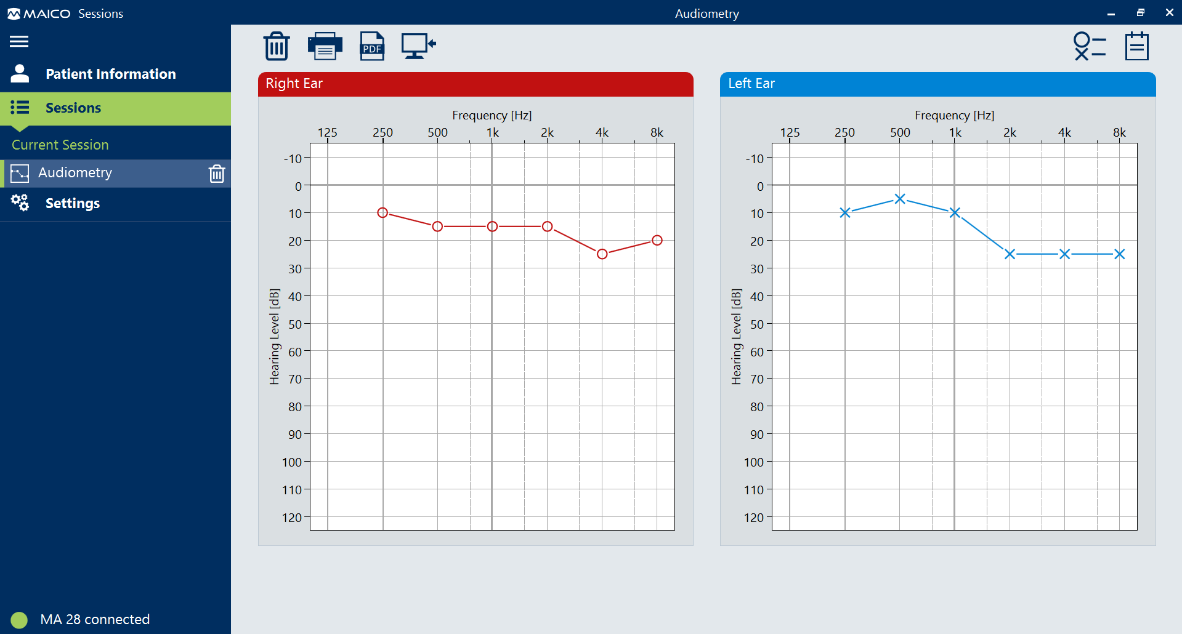
3. Main Features – MAICO Sessions (optional)
Visualization and printing of results
Customizable reports
One click export as PDF or XML
EMR/ EHR Integration via XML
Automatic device detection
Delete result upon transfer

Slide 13
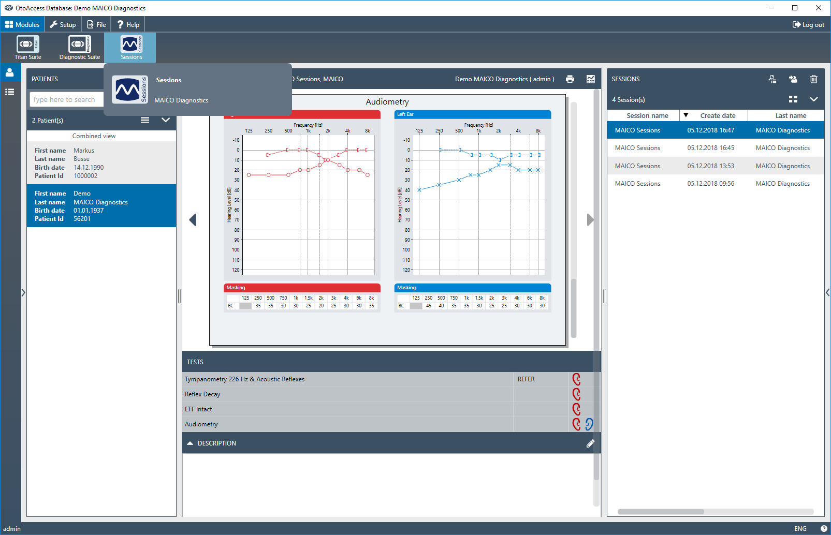
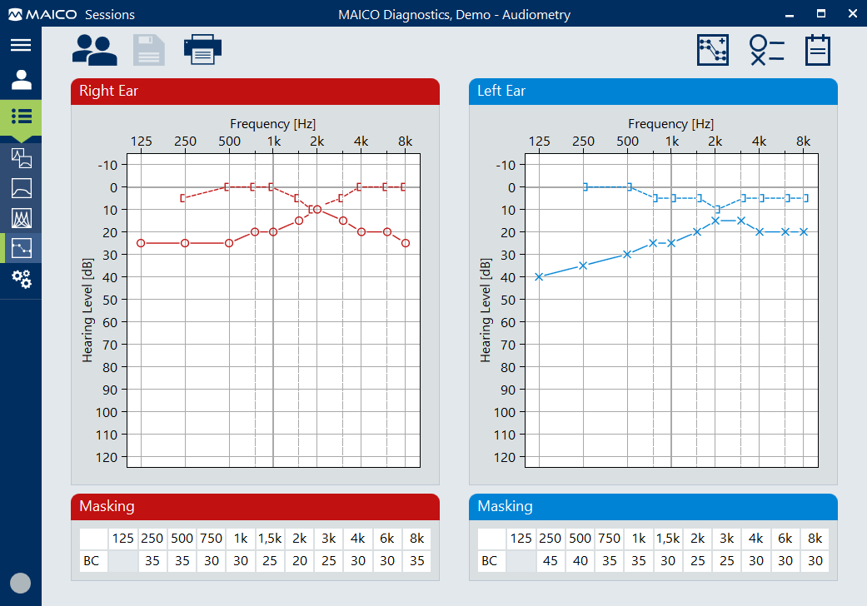
3. Main Features – OtoAccess® Database (optional)
Patient and result management
Multi-brand Database MAICO, Interacoustics
Perfect overview and easy session report and preview access
User Management support
Client/Server Infrastructure
OtoAccess® Database Sessions
Notes:
OA User MM:
Possible to use Windows log on
Customized user permissions

Slide 14
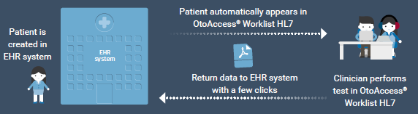
3. Main Features – OtoAccess® Worklist HL7 (optional)
Add-on to OtoAccess® Database
Integration in your existing EHR system
For EHR systems that support HL7 version 2.x in an order-based workflow
Reduces the data-administrative part of the clinical workflow to a few seconds
Save 5-10 minutes per patient

Slide 15

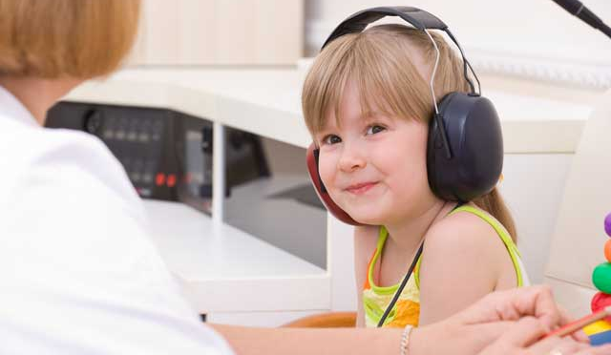
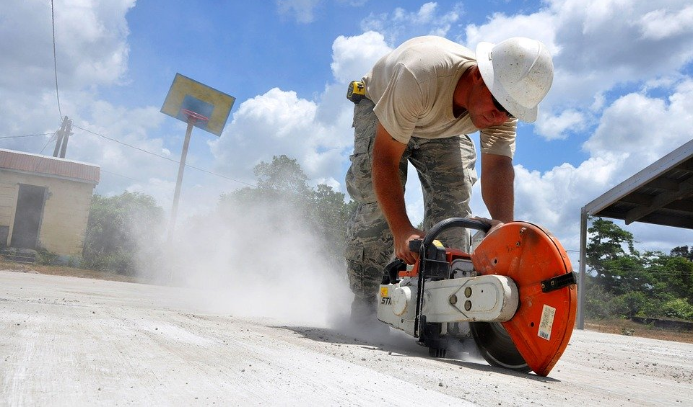
4. Customer / User
School Screenings
Nurse
Audiologist
Teacher
Volunteers
Pediatricians
Nurse
Medical Assistant
Doctors
Occupational Health
Technical Assistants
Audiologists
Doctors (MD‘s)
Notes:
Subjective validation of hearing status

Slide 16
5. Sales Configuration MA 25 - Overview
Step 1:
Standard Version
Step 2:
Optional Extended Version
Step 3:
Optional accessories
MA 25
AC DD45 headset
Accessories included
3 AA batteries
Audiogram Pad
MA 25e
AC DD45 headset
Hughson-Westlake
MAICO Sessions Software
Additional accessories included:
Patient response switch
USB cable
Accessories
DD65 v2 Headset
Patient response switch
Power supply
Carrying case
Database Software
OtoAccess® Database
OtoAccess® Worklist HL7
Noah Database
Notes:
Price for HearSIM includes OtoAccess

Slide 17
5. Sales Configuration MA 27 - Overview
Step 1:
Standard Version
Step 2:
Optional Extended Version
Step 3:
Optional Accessories
MA 27
AC DD45 headset
Accessories included
Audiogram Pad
Power supply
MA 27e
AC DD45 headset
Hughson-Westlake
MAICO Sessions Software
Additional accessories included:
Patient response switch
USB cable
Accessories
DD65 v2 Headset
Patient response switch
Database Software
OtoAccess® Database
OtoAccess® Worklist HL7
Noah Database
Notes:
Price for HearSIM includes OtoAccess

Slide 18
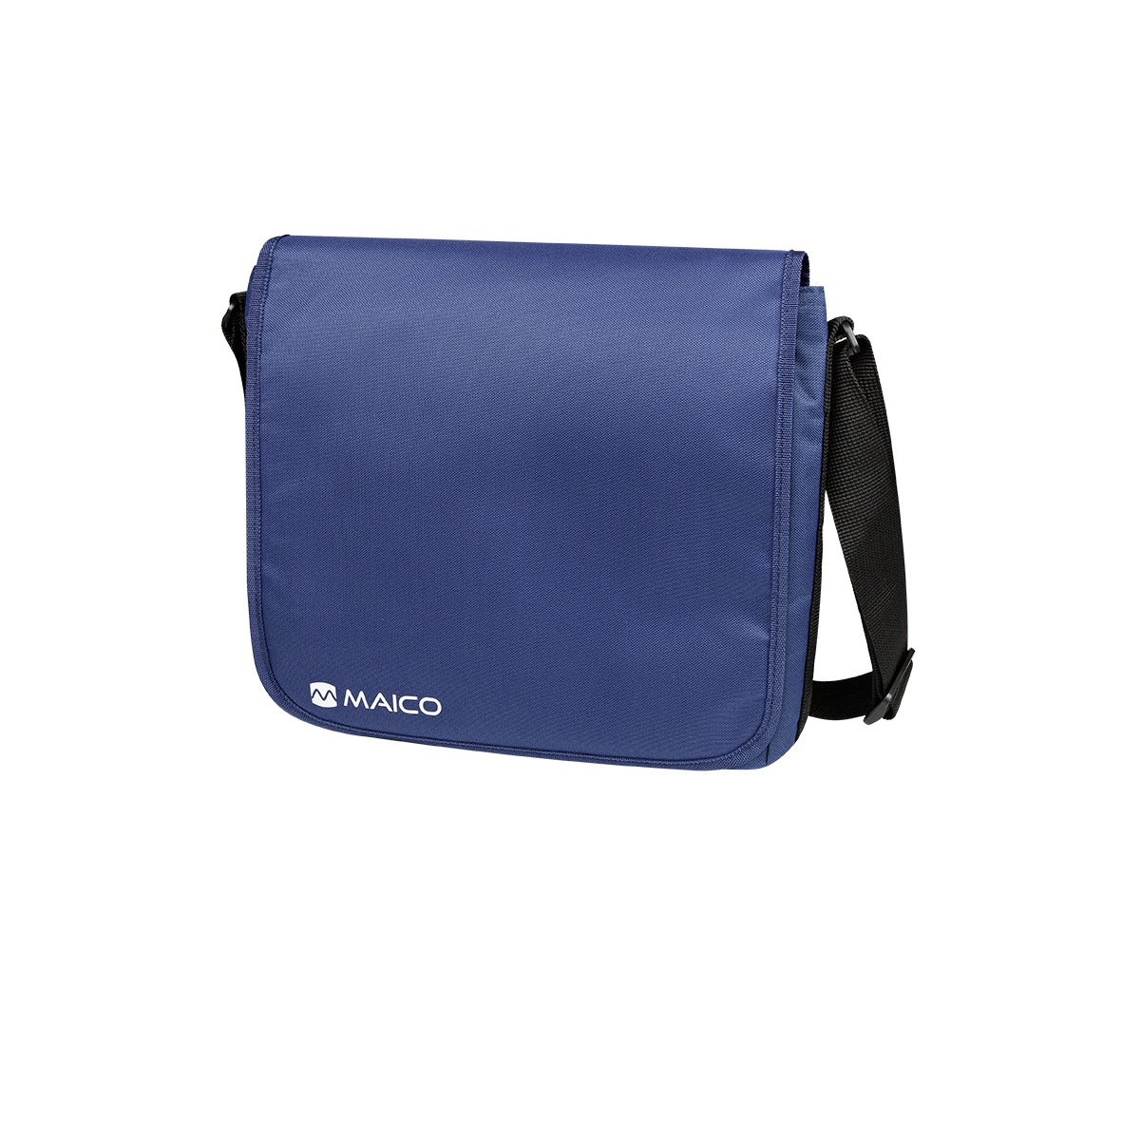
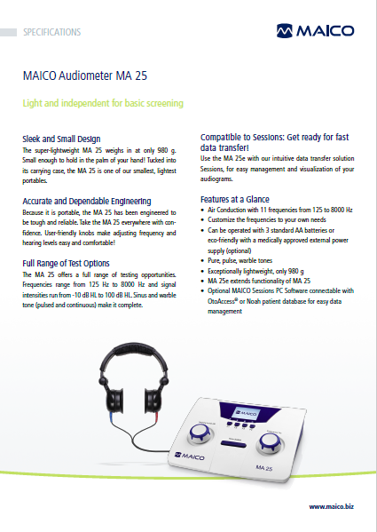
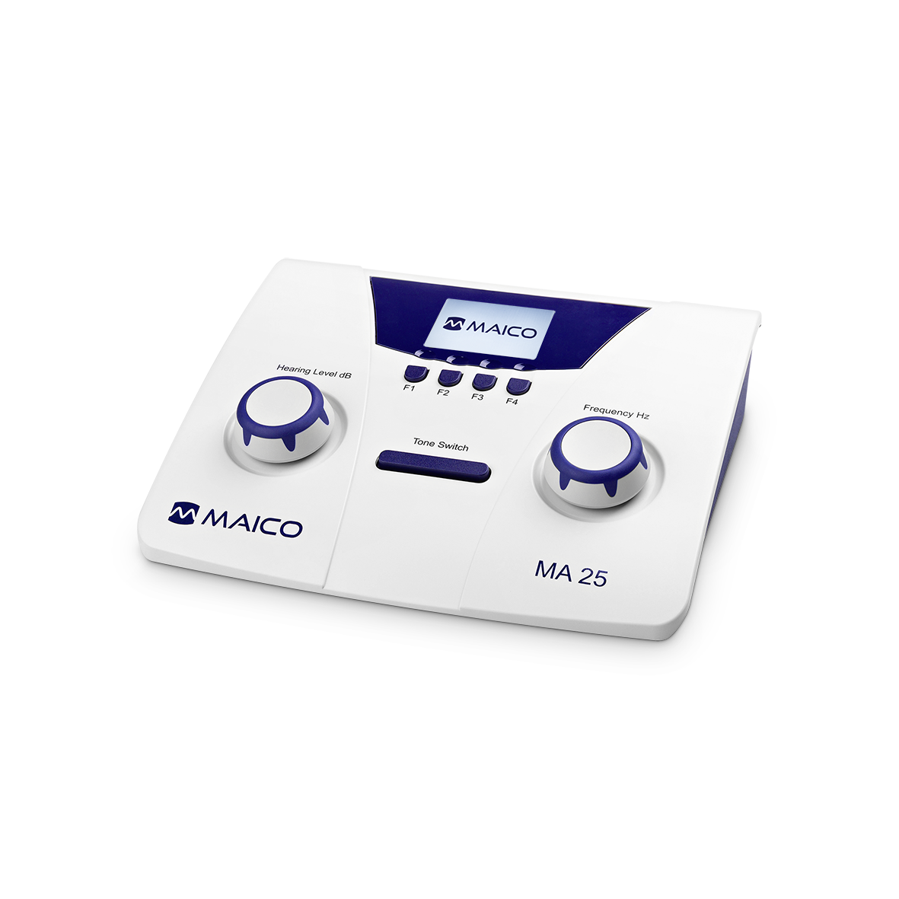
6. Marketing Materials – MA 25
Datasheet
Product pictures

Slide 19
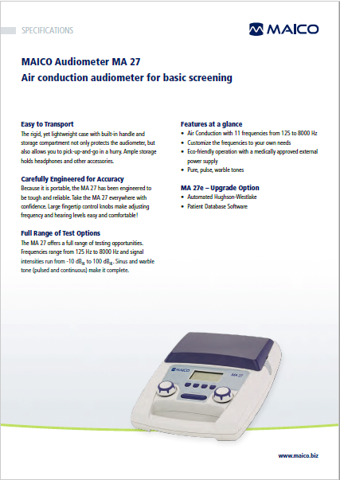
6. Marketing Materials – MA 27
Datasheet
Product pictures

Slide 20
Thank You!

